Slide 1





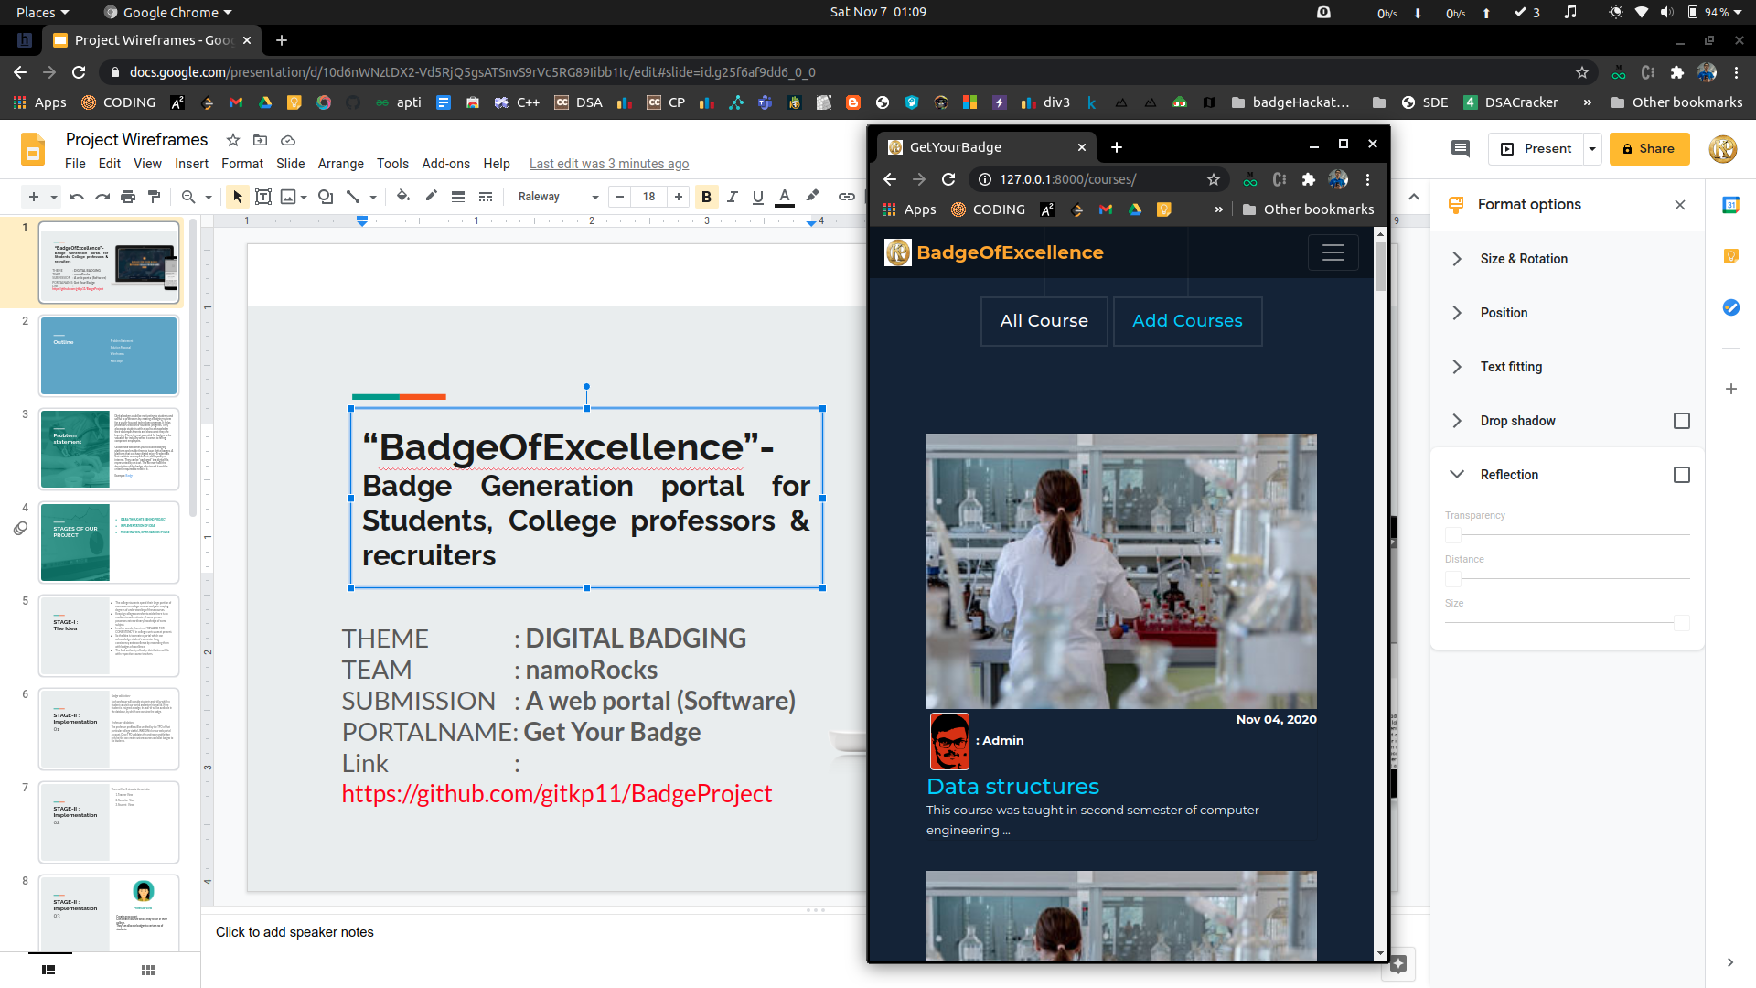
“BadgeOfExcellence”
Digital Badge Generation portal for Students, College professors & recruiters.
THEME : DIGITAL BADGING
TEAM : namoRocks
SUBMISSION : A web portal (Software)
PORTALNAME: BadgeOfExcellence
Link : https://github.com/gitkp11/BadgeProject

Slide 2
Problem Statement
Project Stages
STAGE-I : The Idea
STAGE-II : Implementation
STAGE-III : Presentation, Optimization
BADGE
Technical Stack used
What next?
Web-Portal
Q&A
Outline
<number>

Slide 3
Digital badges could be motivating to students and useful to professors by creating a badging system for a youth-focused technology program. It helps professors track their students’ progress. They also equip students with a tool to acknowledge their accomplishments and show what they are learning. There is great potential for badges to be valuable for industry when it comes to hiring competent employees.
Globalshala welcomes you to build a badging platform and enable them to issue digital badges. A platform that can have digital micro-credentials that validate accomplishment, skill, quality or interest. They can be “packaged” in a digital file, represented by an icon. The file may hold the description of the badge, who issued it and the criteria required to receive it.
Example: Badgr
Problem statement
<number>

Slide 4
IDEAS/THOUGHTS BEHIND PROJECT
IMPLEMENTATION OF IDEA
PRESENTATION, OPTIMIZATION PHASE
PROJECT STAGES
<number>

Slide 5
The college students spend their large portion of resources on college courses and gain varying degrees of understanding of these courses.
Keeping college score sheets aside, there is no medium to authenticate , if some person possesses extraordinary knowledge of some subject.
In other words, there is “ No REWARD FOR CONSISTENCY” in college curriculum at present.
So the Idea is to create a portal which can acknowledge student’s semester-long consistency and excellence by rewarding them with badges of excellence.
The final authority of badge distribution will lie with respective course teachers.
STAGE-I : The Idea
1
<number>

Slide 6
Badge validation:-
Each professor will provide students mail-id by which a student can visit our portal and enter his mail id.
If the student is assigned a badge, its mail-id will be available in the database, by which one can view the badge.
Professor validation:
The professor profile will be verified by the TPO of that particular college via his LINKEDIN id or our web portal account.
Once TPO validates the professor profile then only he/she can create custom courses and allot badges to his students.
STAGE-II : Implementation 01
<number>

Slide 7
STAGE-II : Implementation 02
THERE WILL BE THREE VIEWS TO THE PORTAL
PROFESSOR VIEW
RECRUITER VIEW
STUDENT VIEW
<number>

Slide 8

STAGE-II : Implementation 03
Professor View
Create an account
Can create courses which they teach in their college.
They can allocate badges to certain no of students.
<number>

Slide 9

STAGE-II : Implementation 04
Student View
Students won't be having their account on the portal.
They can enter their email id on the homepage.
If the student is allotted a badge, a digital badge will be created wherein they can download or view the file.
We will describe the badge file later in separate slide.
They can even compare their skills with students from other courses available on the portal wherein they will get insights of how well prepared they are for the industry.
<number>

Slide 10

STAGE-II : Implementation 05
Recruiter View
They will be able to view the homepage where all the courses are listed
They also get insights of student details, who have been allotted certain badges in respective courses, enhancing their visibility to industry ready student.
They will also be able to view various skills honed by students by having a visibility access to respective GitHub or LinkedIn id’s of students.
They can also directly contact course professors in case of discripencies.
<number>

Slide 11
STAGE-III : Presentation, Optimization
Our portal will provide recruiters an opportunity to hire skilled and industry ready students.
They don’t need to conduct tiring recruitment processes which will save their resources and time.
It will provide students an opportunity to showcase their skills and get rewarded for their consistency.
This idea (project) fits well within present realms of working of hiring so it can be an asset for colleges as it will provide wide reach to students apart from available sources like LinkedIn, Internshala, TPO office, etc.
The students getting a token of appreciation for studying college courses sincerely can enhance their skill set.
<number>

Slide 12
Badge Structure
The generated badge will contain:
Name of student
Date on which badge is allotted
Course in which student is endorsed
QR-code generated on the basis of URL of badge file
(On scanning the badge on will be redirected to badge file on our portal)
<number>

Slide 13
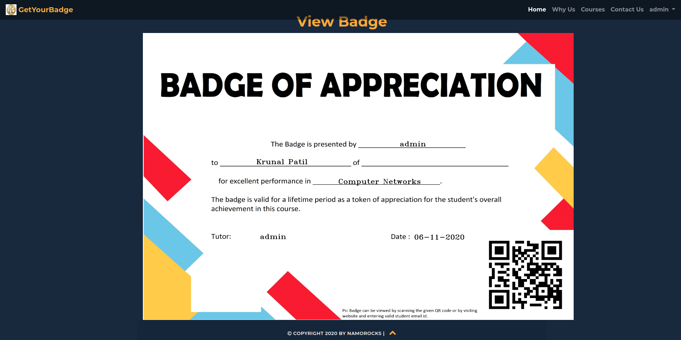
<number>

Slide 14
Technical Stack used
Technology, architecture used:
Django-3.1.2
Python-3.5.8
PiP libraries used:
django-allauth==0.43.0
django-crispy-forms==1.9.2
opencv-python==4.4.0.44, Pillow==8.0.1
qrcode==6.1
Database Used:
DB-SQlite3
<number>

Slide 15
What next?
Add Student profile wherein one can display all allotted badges, resumes, courses mastered, ratings of various Coding platforms, any other achievements, etc.
Recruiters can visit and check the overall progress of student from our platform itself.
Recruiters can message teachers, TPO’s, Students from our site and get in touch for better connection further.
<number>

Slide 16
HEAD OVER TO WEBSITE PORTAL “BadgeOfExcellence”
<number>

Slide 17
Questions? From team “namoRocks” Krunal Patil Swapnil Singh Suraj Kekan (All three from Army Institute of Technology, Pune)
<number>

Slide 18
THANK YOU
<number>

